Slide 1
Year 3
2023 - 2024

Slide 2
Welcome to Year 3
3 Hawthorn: Miss Bastick
Miss Hurley (Mondays)
3 Bramble: Ms Davis/Ms Christopher
LSAs: Ms Howell and Ms Yousef

Slide 3
Library
Children will have a library session once a week.
Children will be able to borrow one book every week to read for pleasure.
Year 3’s library day is Wednesday.
Finished library books can be swapped, unfinished library books renewed.
Please return any old library that you might still have at home.

Slide 4
Reading
Banded books will be read in school and recorded in their reading diaries.
Every Friday your child will bring a banded book home to read to/with you. Please ensure that book is brought to school everyday.
When you read with your child, please write a comment in their reading record
Reading records and banded books should be kept in bags at all times.

Slide 5
Curriculum
Details of all topics studied in year 3 are available on the website including knowledge organisers.

Slide 6
PE – Wednesday’s and Friday’s
Children should come to school wearing their PE kit with house colour t-shirt.

Slide 7
Morning Playtime Snack
Year 3 children are encouraged to bring a small snack for morning break.
This has to be fruit or vegetables.

Slide 8
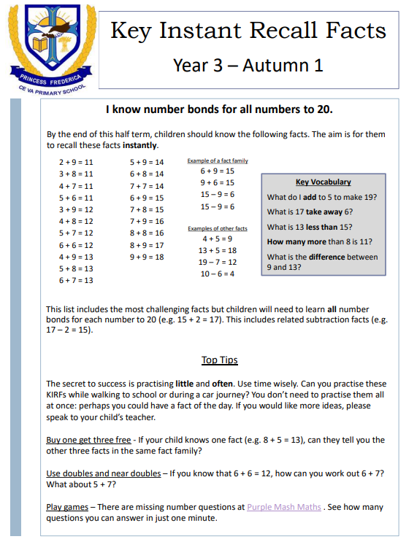

Slide 9
Homework
Maths – Mathletics homework will be set on Fridays each week.
Times tables
reviewing 2, 5 and 10 this term
multiplication and division
by the end of Y3, ‘recall and use multiplication and division facts for the 3, 4 and 8 multiplication tables’
Spelling – weekly paper copy given out on Friday. No weekly test but spellings will be monitored in all written work.
Homework projects – these projects are linked to a topic studied each half term. Children are given the opportunity to present them to the class on a given date.

Slide 11
Communication with Teachers
Please contact the school office via email if you wish to discuss something. Alternatively, we are able to speak in the playground at pick-up.
Email: admin@princessfrederica.com
Class teacher
Head of school: Ms. Christopher
Executive head Teacher: Ms. Bouette

Slide 12
Punctuality
All Year 3 children line up in the KS2 playground at 8:50am. (gates open 8:40am)
End of day pick up time is at 3:30pm in the KS2 playground.
Any pick changes need to be emailed by 3pm.

Slide 13
Trips
Our 3 day residential trip to Celtic Harmony Village in June – details to be confirmed.
Celtic Harmony Camp, Bourne Wood, Brickendon Ln, Brickendon, Hertford SG13 8NY
Tuesday 25th – Thursday 27th June 2023.
https://www.celticharmony.org/about-us/
Day trips to be confirmed.

Slide 14
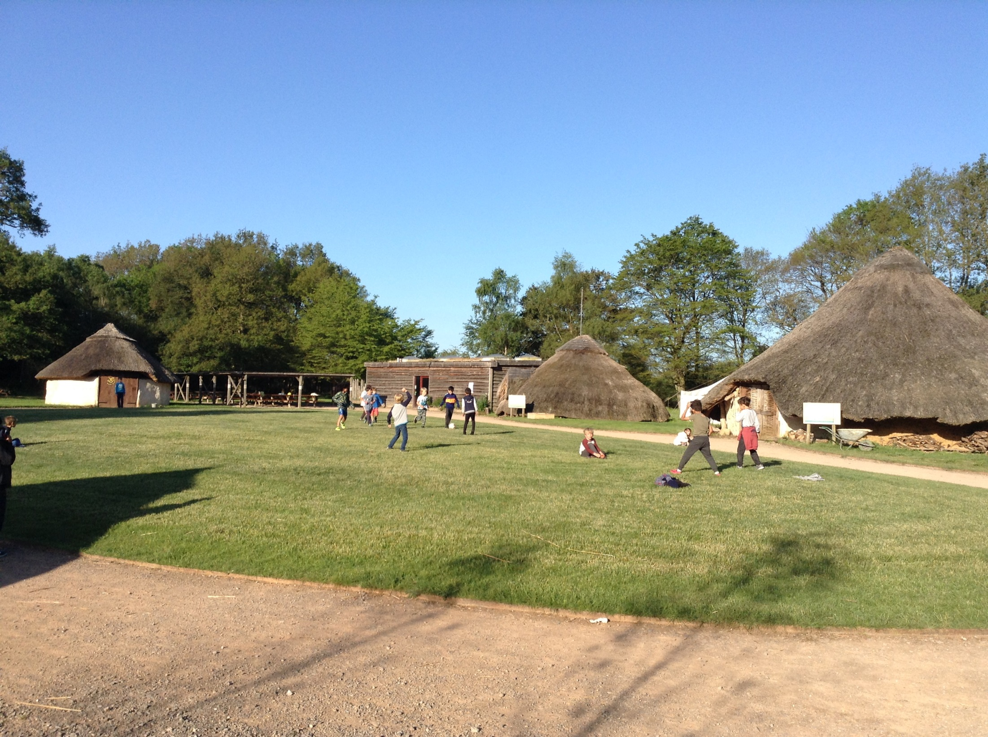
Celtic Harmony Residential
Tuesday 25th – Thursday 27th June 2024

Slide 15
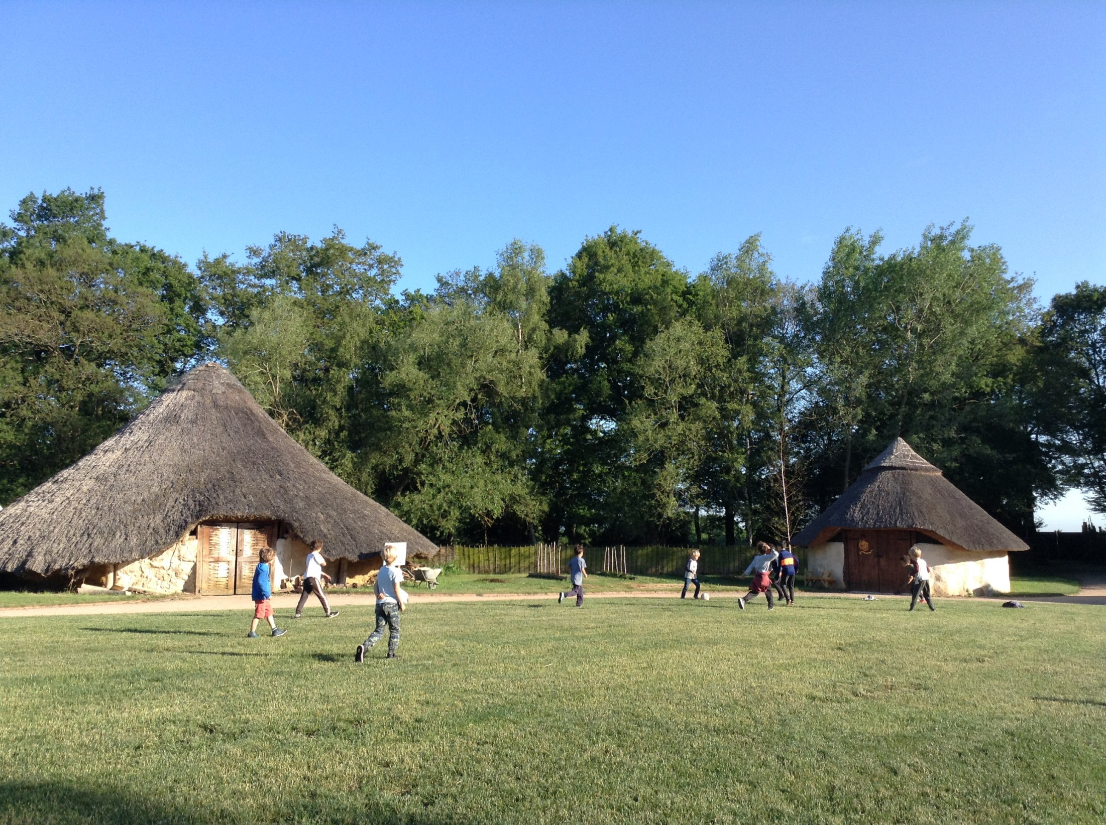

Slide 17
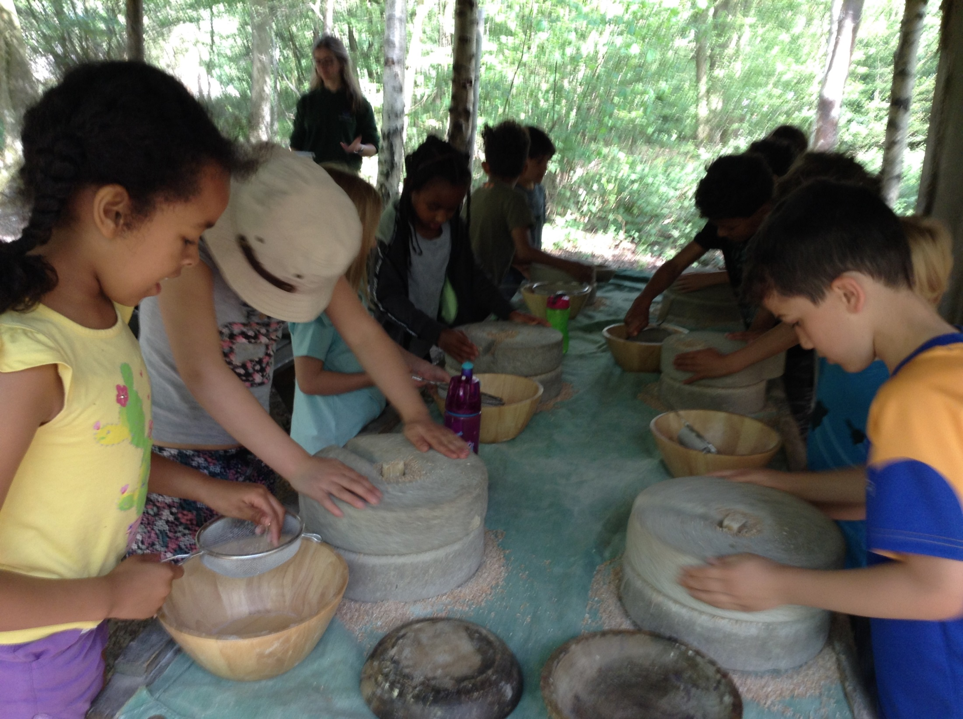

Slide 18
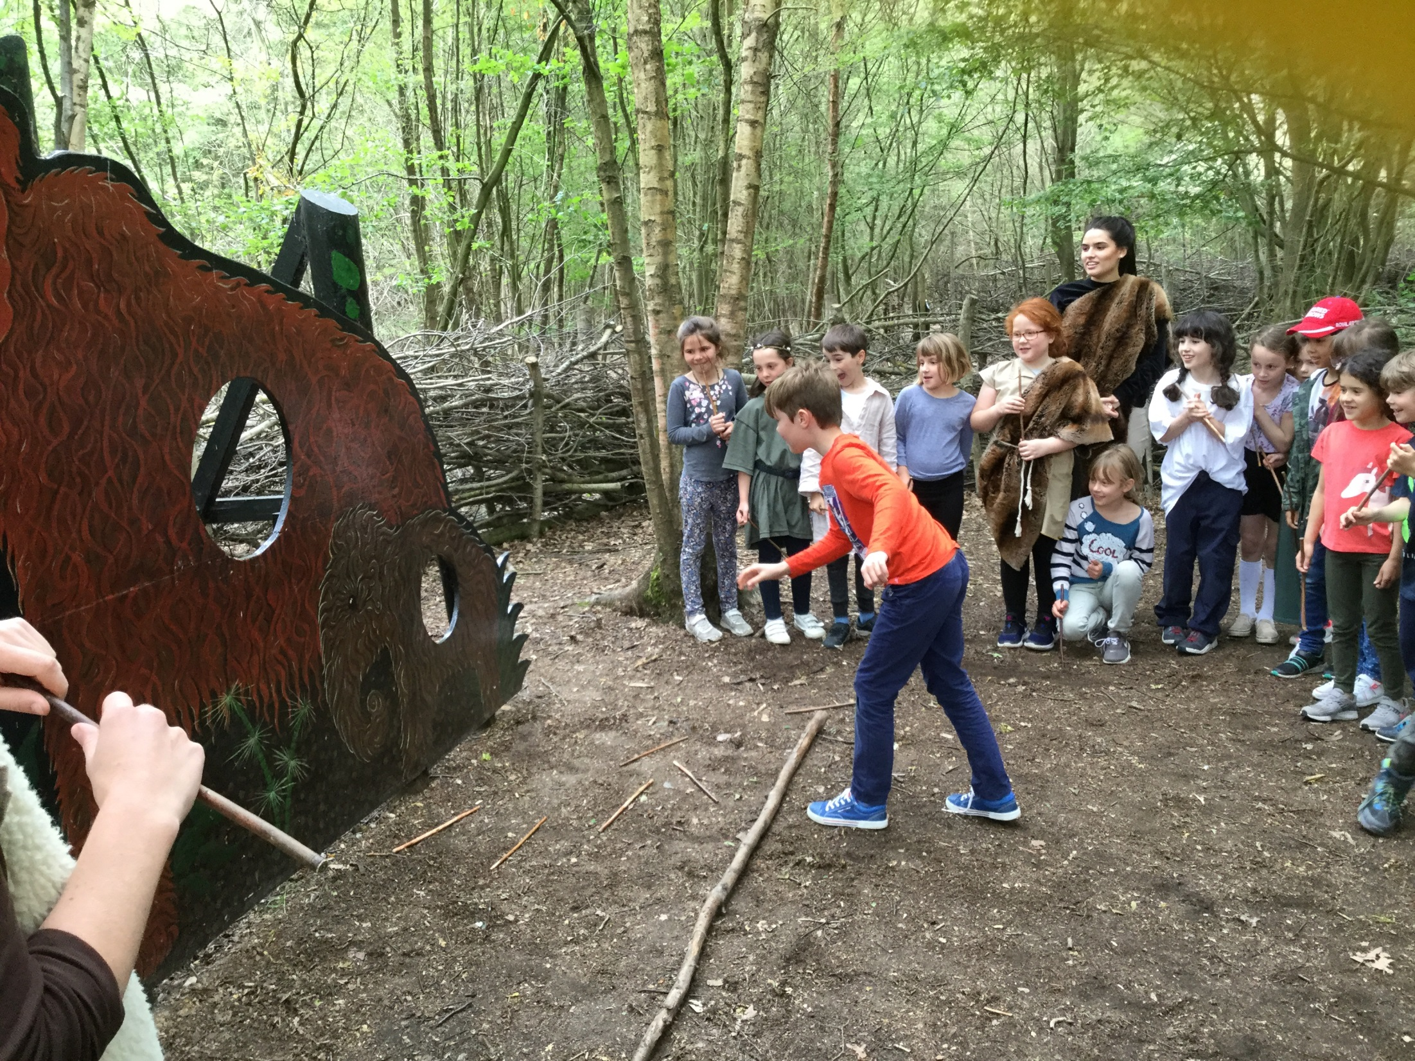

Slide 19
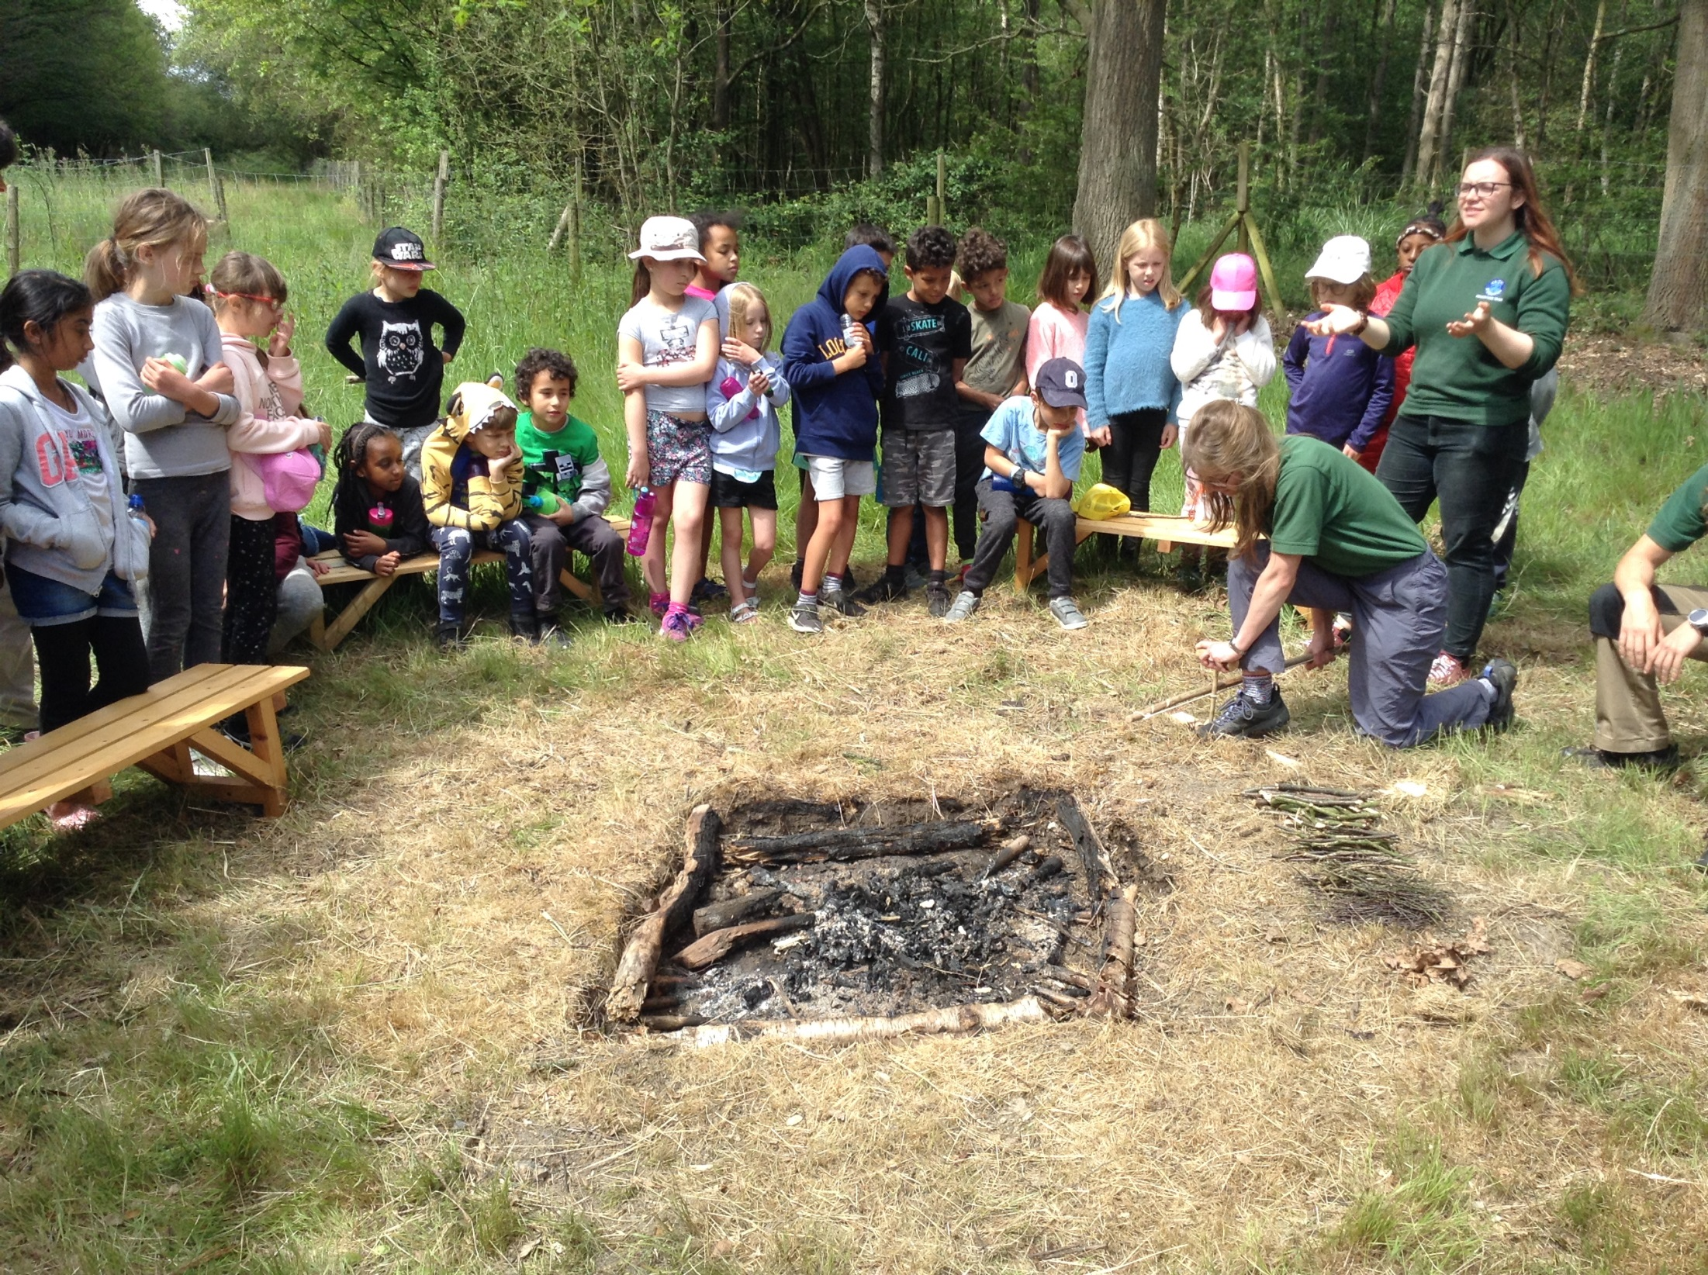

Slide 20
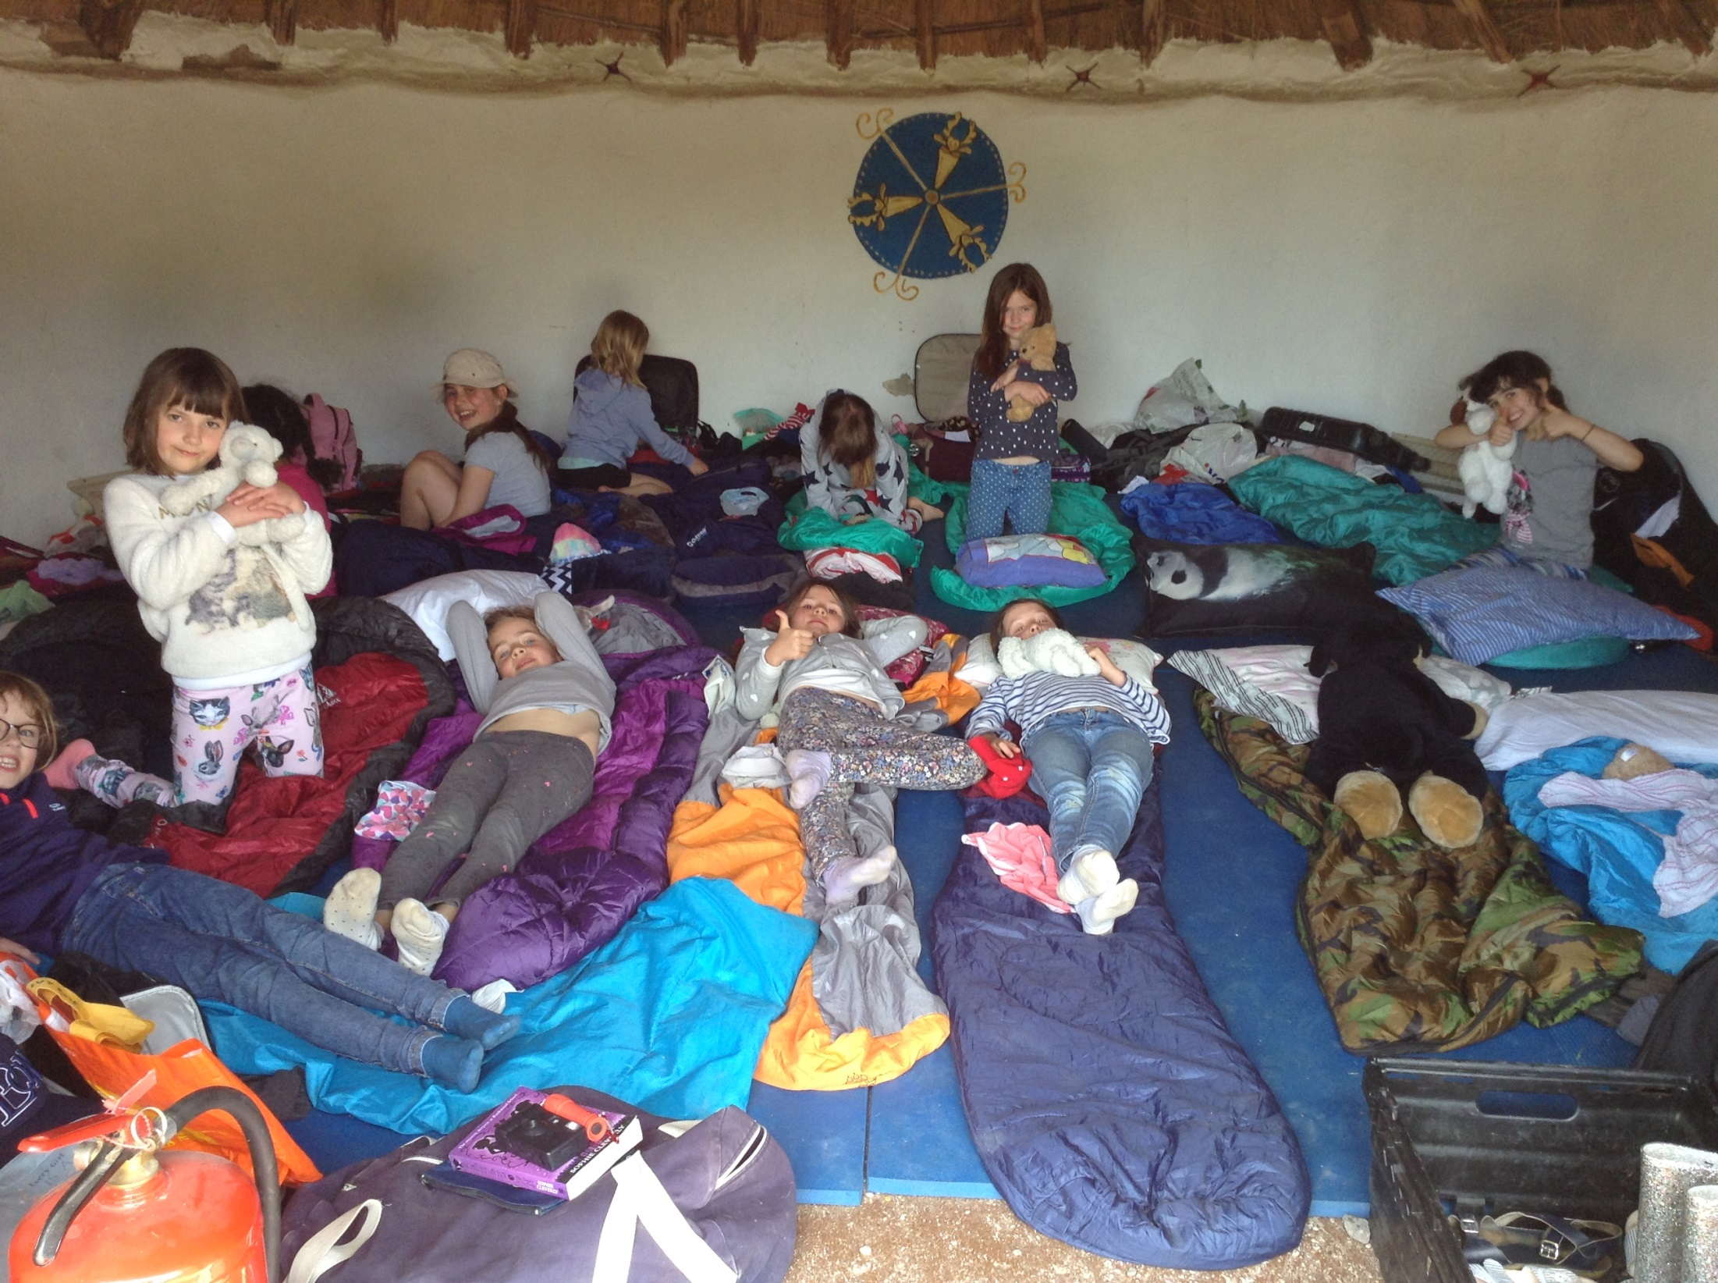

Slide 21
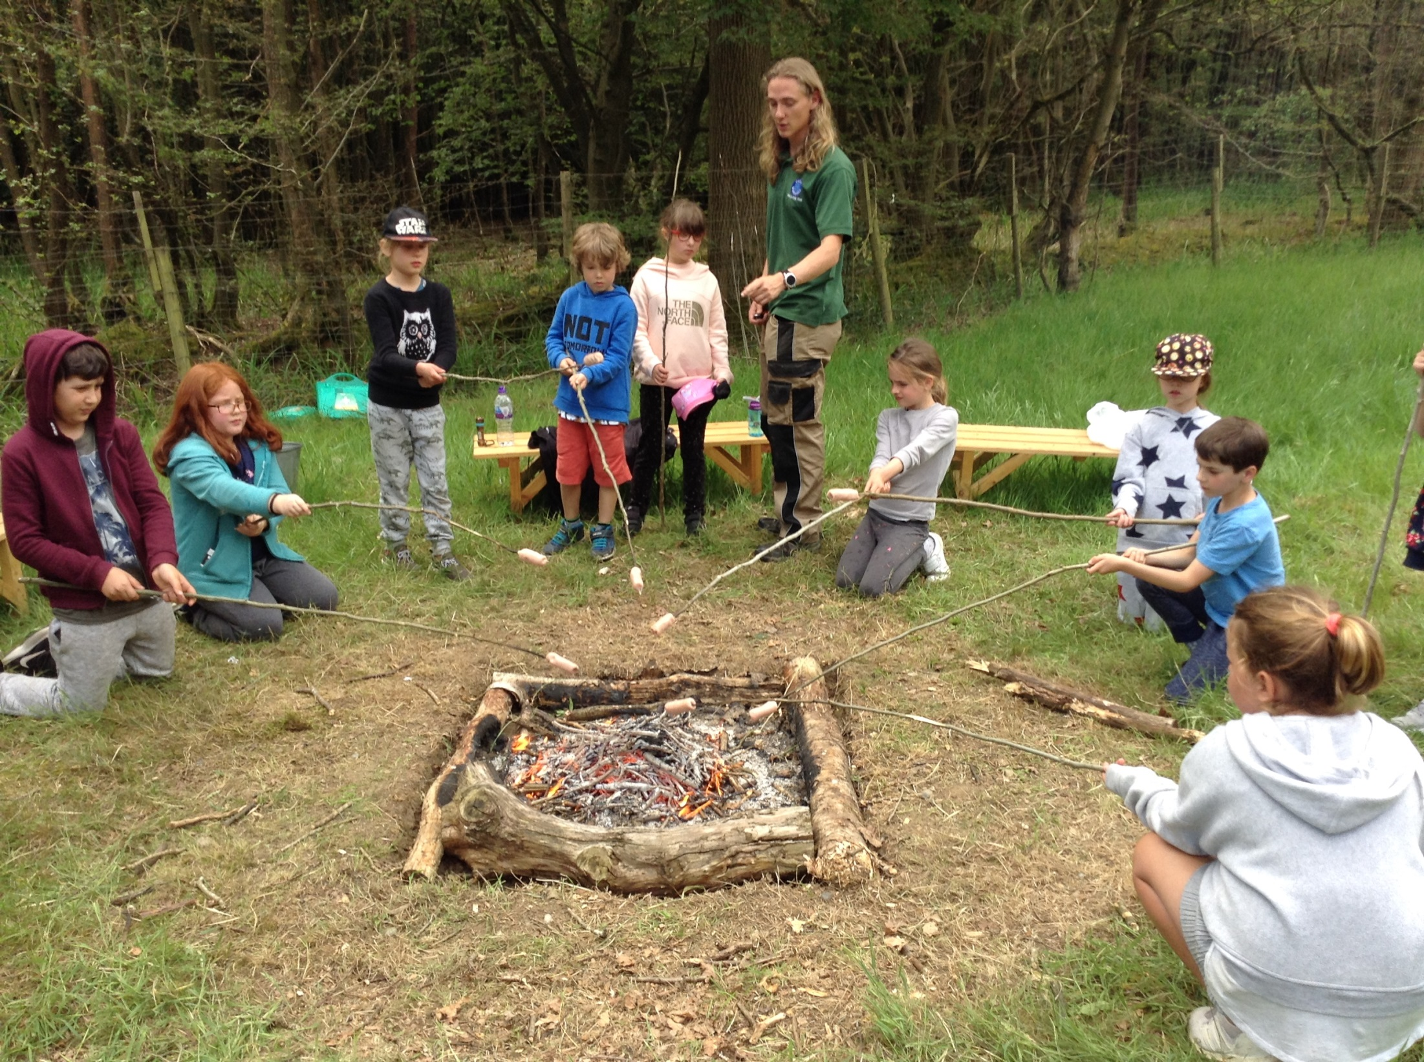

Slide 22
Any questions?
Thank you for attending.

